Slide 1


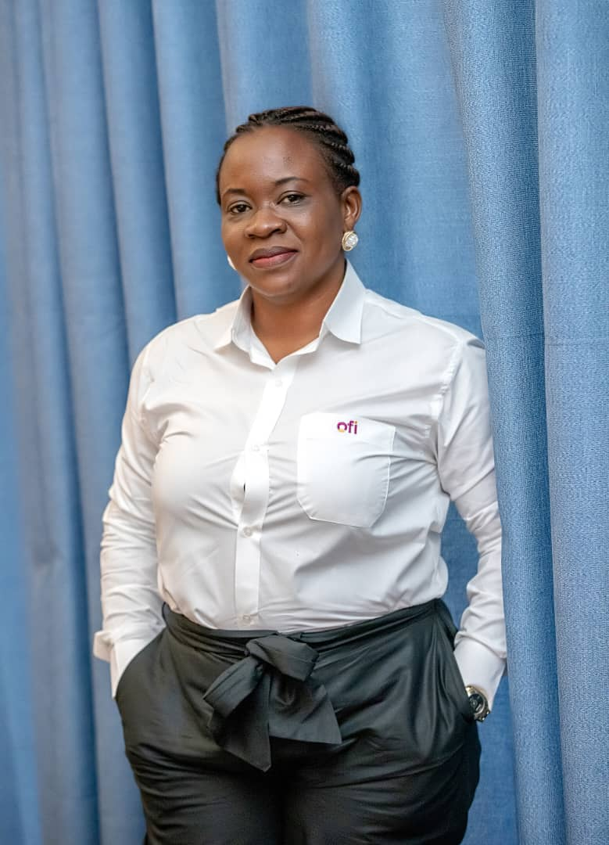

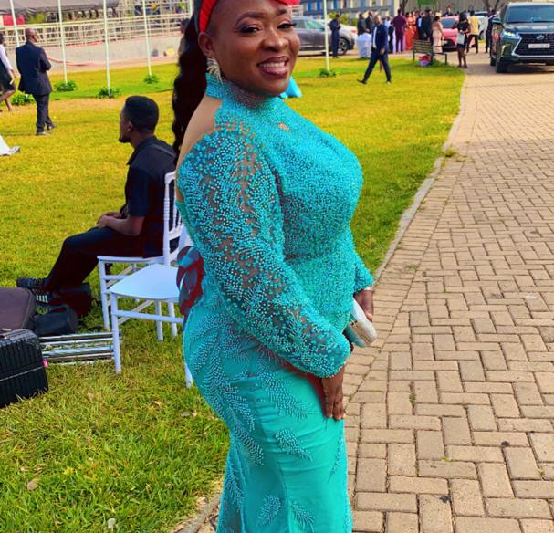
Getting to Know Me
Work
Personal
My role
Quality and Food Safety Manager
Significant others / family members / furry friends in my life
Mr. Akwasi Ackoom – my husband
Philip and Eric – my sons
Tenure in ofi/Olam
Sixteen years and counting
How I enjoy spending my free time
Cooking for my family new recipes that I want them to enjoy.
Previous companies I have worked at
Guinness Ghana Breweries Limited
My favorite / comfort food
Ghana Jollof with spicy chicken/fish/meat
Why I joined ofi/Olam and what keeps me here?
I joined ofi/olam because it is a learning organization which has groomed me in my career. The aspect of always learning, unlearning and relearning has shaped me to face this unchanging world , which is why I am still in ofi.
My favorite song
Mercy by Moses Bliss
MARY ARTHUR
“Mary”
Non-conformity!
This is me outside work, doing stuff I enjoy in my life …

